Slide 1
Label Noise in Classification
Jason King - jking@xsolis.com

Slide 2
Introduction
Physicist-turned-data-scientist
Single molecule trapping
Particle metrology
Simulations
Senior data scientist at XSOLIS
Case management solutions
Level of care
Length of stay
Automated coding
We are hiring!

Slide 3
Label Noise

Slide 4
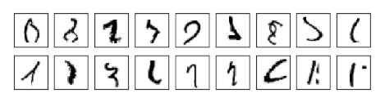
MNIST
Nielsen, Michael. Neural Networks and Deep Learning.
Notes:
The orange indicates that a radiologist did not think there was enough information to diagnose from the image alone. The red are ones where he actively disagreed.

Slide 5
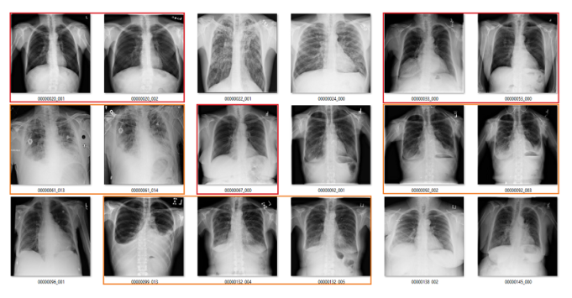
ChestXRay14
Fibrosis
Oakden-Rayner, L. Exploring the ChestXray14 dataset: problems.
Notes:
The orange indicates that a radiologist did not think there was enough information to diagnose from the image alone. The red are ones where he actively disagreed.

Slide 6
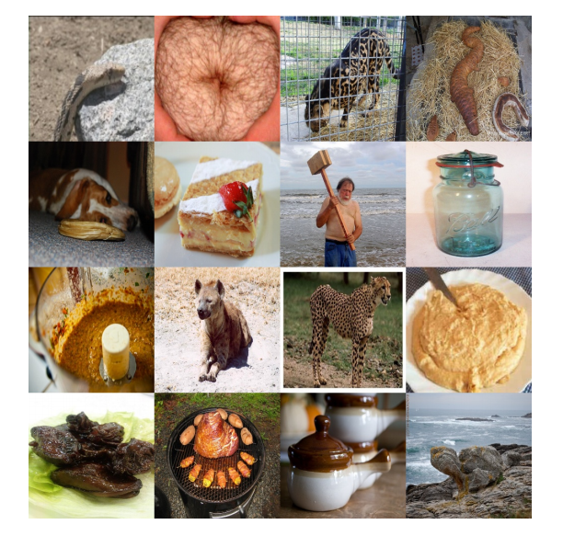
ImageNet
Ekambaram, R., Goldgof, D.B., and Hall, L.O. "Finding label noise examples in large scale datasets,"
Notes:
Top down, left to right: alligator, bagel, cheetah, crocodile, donut, french bread, hammer, hatchet, italian bread, jackal, jaguar, ladle, oyster, plate, soup bowl, tortoise.

Slide 7
Objectives
Understand the various types of label noise
Investigate their effects
Fabricate simple datasets
Simulate label noise
Methods to mitigate label noise effects

Slide 8
Types of Label Noise
NCAR: Noisy Completely At Random
The probability of error is entirely random
Uniform label noise
NAR: Noisy At Random
The probability of error depends on the true class, Y
Asymmetric label noise
NNAR: Noisy Not At Random
The probability of error is dependent on the true class, Y, and the features, X
Most generalized form
Near the decision boundary
In low-density regions

Slide 9
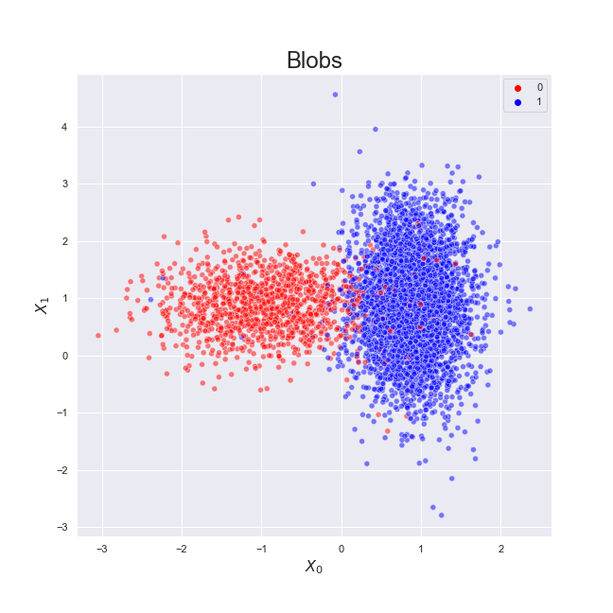
0: 1267
1: 3733

Slide 10
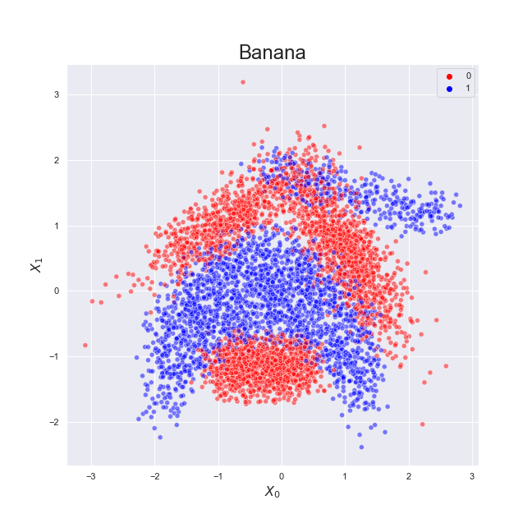
0: 2924
1: 2376

Slide 11
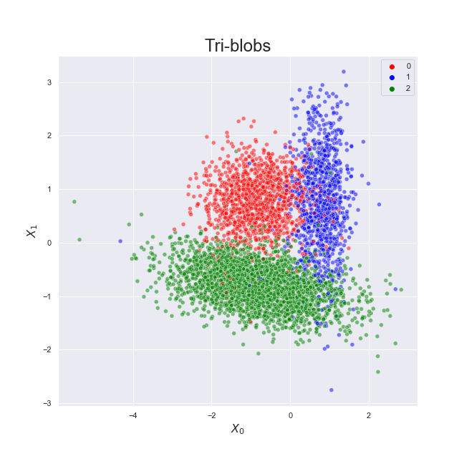
0: 1260
1: 999
2: 2741

Slide 12
Baseline performance
Dataset
Simple models
Blobs: Logistic Regression
Banana: K-Nearest Neighbors (k=10)
Tri-blobs: Random Forest (n=20)
Evaluation metric
Methodology
200 samples per dataset
Split into train/test
Train model
Generate predictions
Compute metrics
Gather results

Slide 13
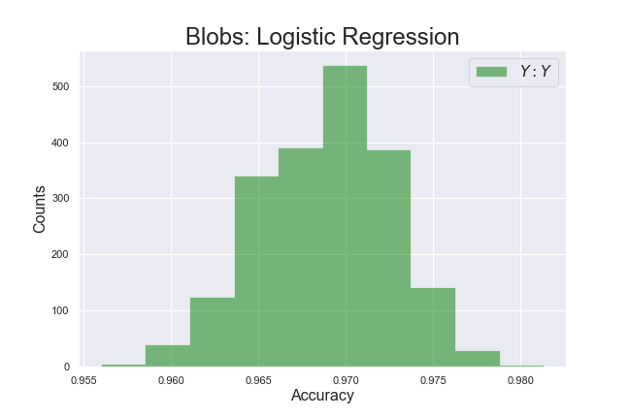

Slide 14
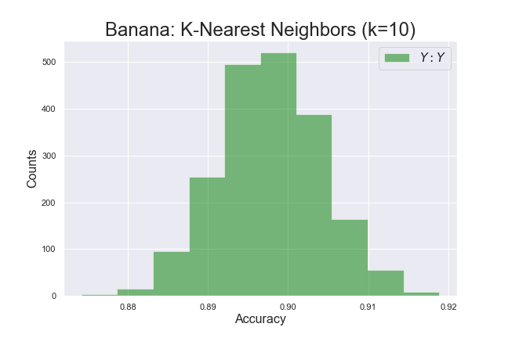

Slide 15
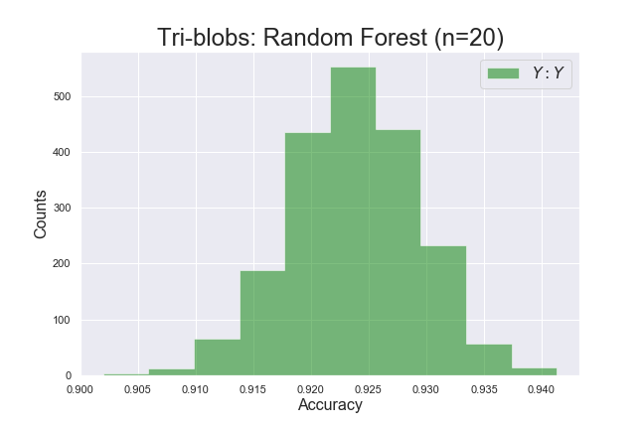

Slide 16
Performance with Noise
Dataset
Dataset
Simulate noise
Split into train/test
Split into train/test
Add Noise!
Train model
Train model
Generate predictions
Generate predictions
Compute metrics
Compute metrics
Gather results
Gather results

Slide 17
Simulate Noise
Requirements
Type of noise
Amount
Generalized framework
Permute dataset
For each point in dataset:
Generate sampling weights
Sample new label
Check noise level
Repeat steps 1 and 2 until desired amount of noise is reached

Slide 18
Simulated NCAR
Dataset
Simulate noise
Noise Completely at Random
Not dependent on features or true label
Uniform sampling weights
Split into train/test
Train model
Generate predictions
classes = [0,1,2]
weights = [1,1,1]
y_new = numpy.random.choice(classes, p=weights)
Compute metrics
Gather results

Slide 19
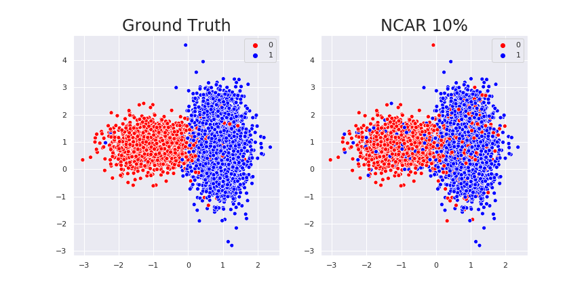
Blobs: NCAR

Slide 20
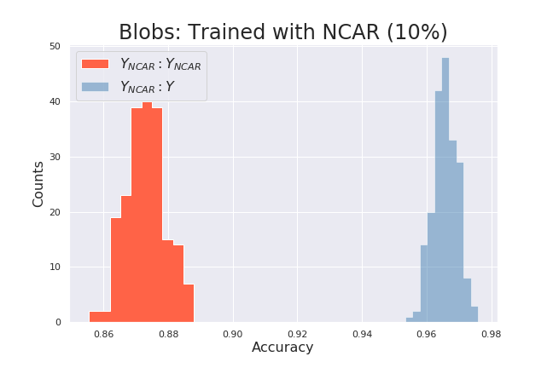
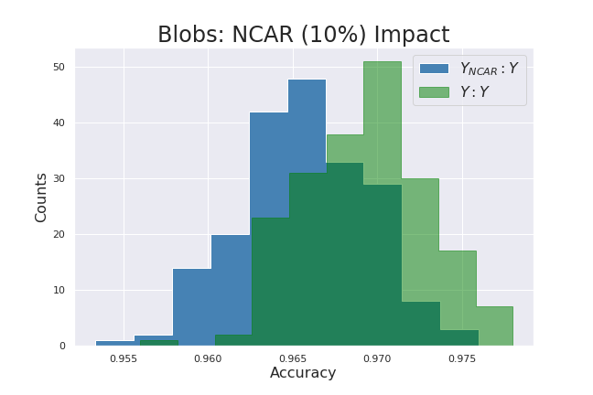
Blobs: NCAR

Slide 21
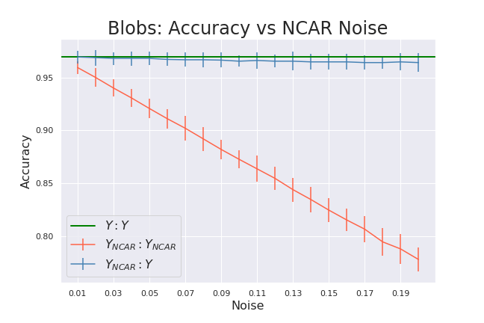

Slide 22

Blobs: NCAR (Tuned)

Slide 23
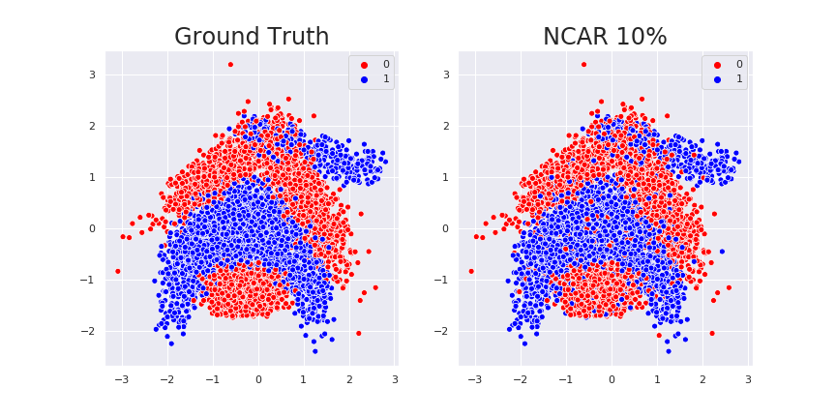
Banana: NCAR

Slide 24
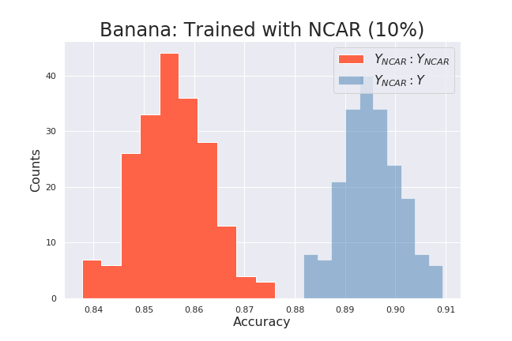
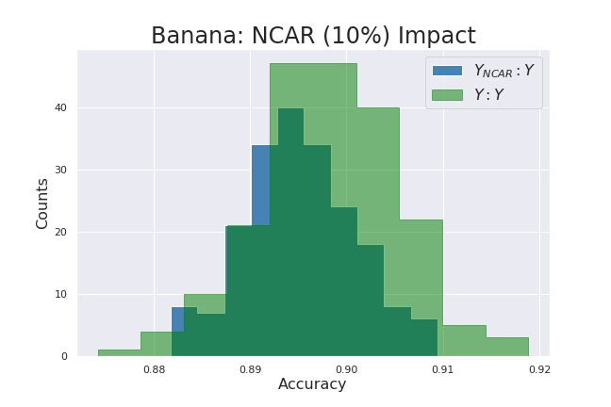
Banana: NCAR

Slide 25
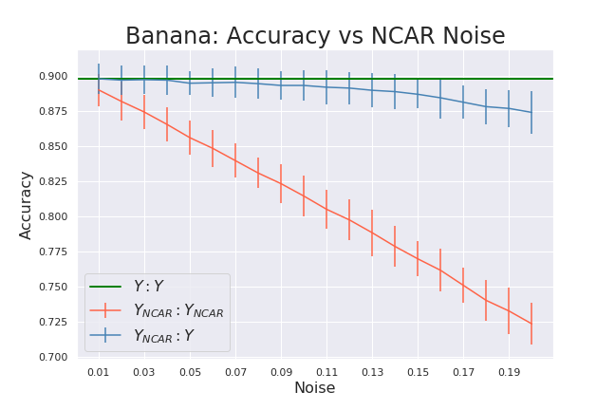

Slide 26
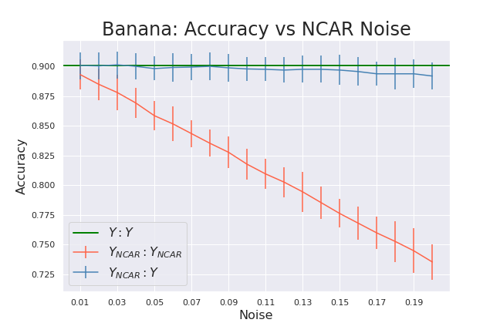
Banana: NCAR (Tuned)

Slide 27
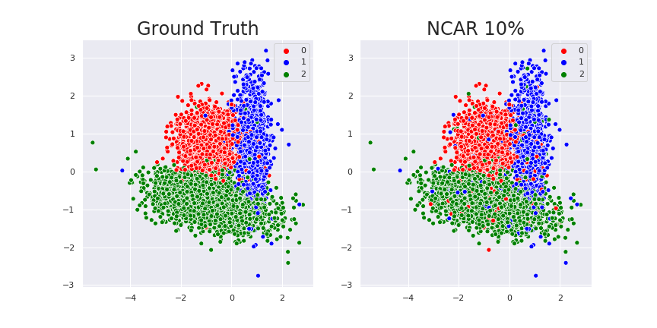
Tri-blobs: NCAR

Slide 28
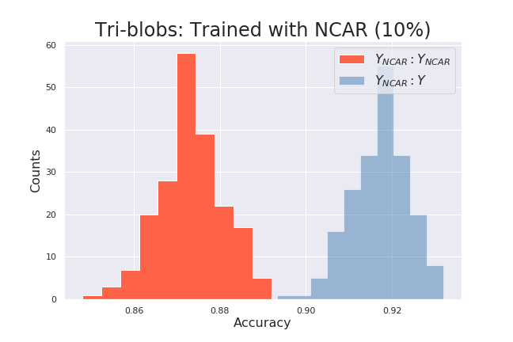
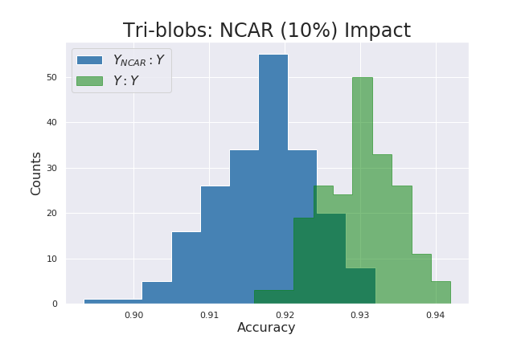
Tri-blobs: NCAR

Slide 29
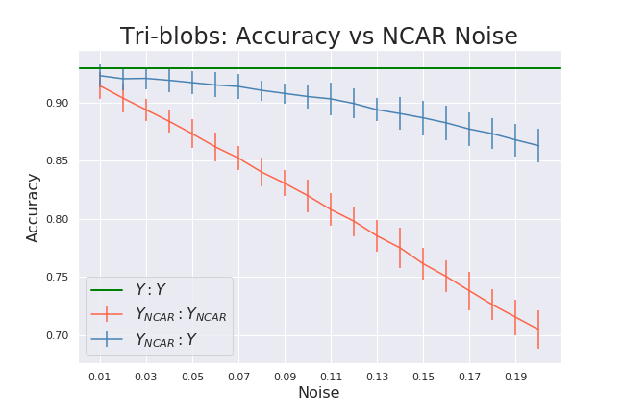

Slide 30
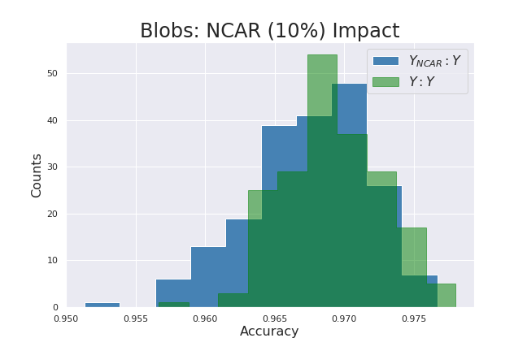
Tri-blobs: NCAR (Tuned)

Slide 31
Simulated NAR
Dataset
Simulate noise
Noise at Random
Dependent on true label
Sampling weights scaled by class size
Split into train/test
Train model
Generate predictions
classes = [0,1,2]
weights = [1260, 999, 2741]
y_new = numpy.random.choice(classes, p=weights)
Compute metrics
Gather results

Slide 32
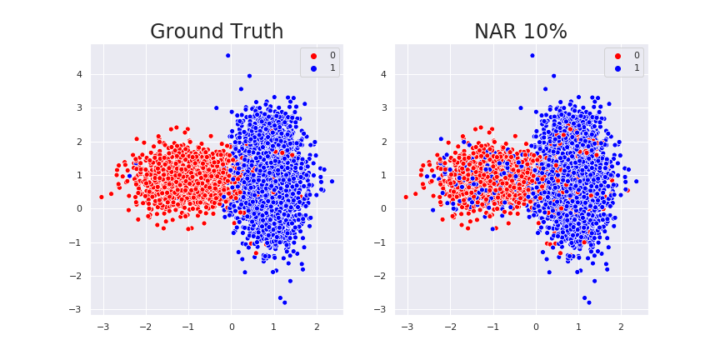
Blobs: NAR

Slide 33
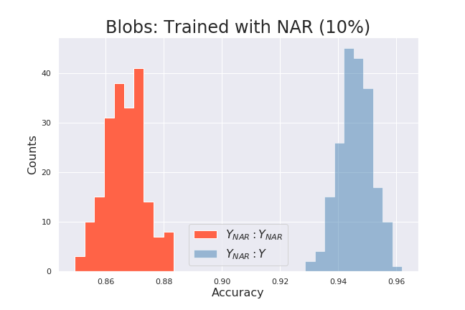
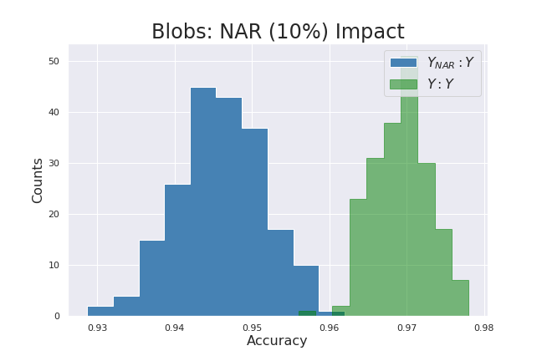
Blobs: NAR

Slide 34
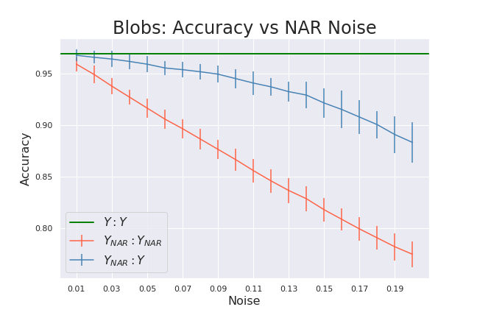

Slide 35
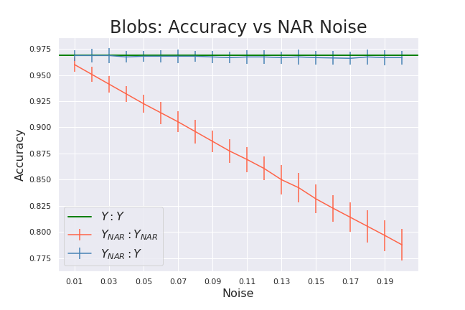
Blobs: NAR (Tuned)

Slide 36

Banana: NAR

Slide 37
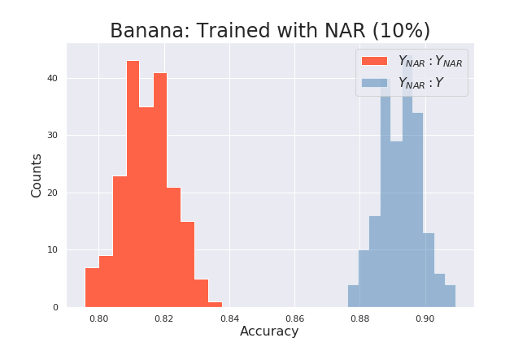
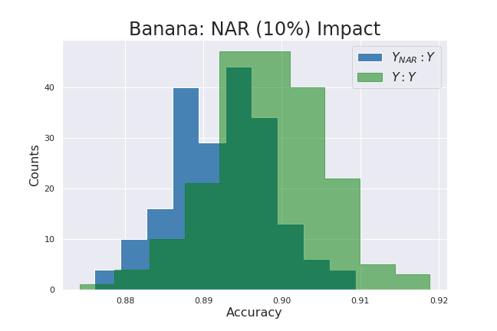
Banana: NAR

Slide 38
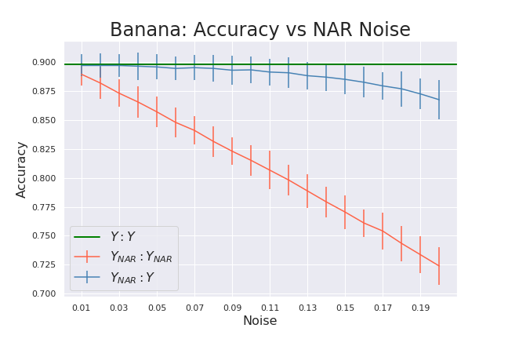

Slide 39
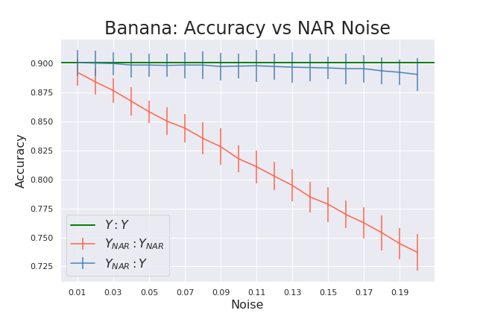
Banana: NAR (Tuned)

Slide 40
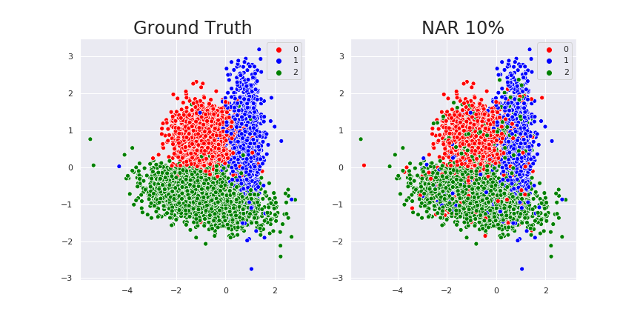
Tri-blobs: NAR

Slide 41
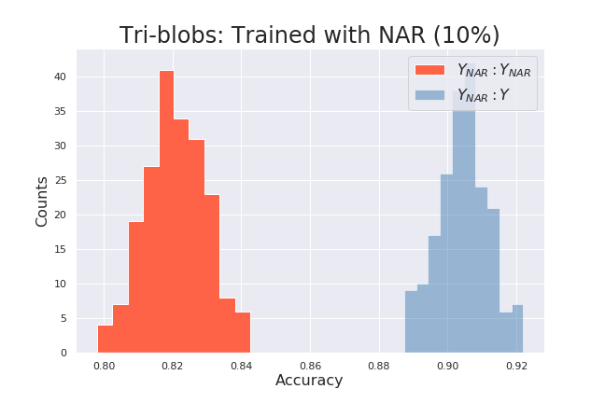
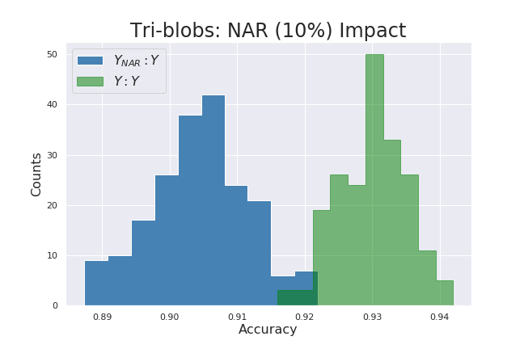
Tri-blobs: NAR

Slide 42


Slide 43


Tri-blobs: NAR (Tuned)

Slide 44
Simulated NNAR
Dataset
Simulate noise
Noise Not at Random
Dependent on true label and features
Sampling weights scaled by:
Class size
Class representation near instance (i)
Split into train/test
Train model
Generate predictions
Compute metrics
classes = [0,1,2]
weights = [1260, 999, 2741]
weights *= knn.predict(X[i])
y_new = numpy.random.choice(classes, p=weights)
Gather results

Slide 45
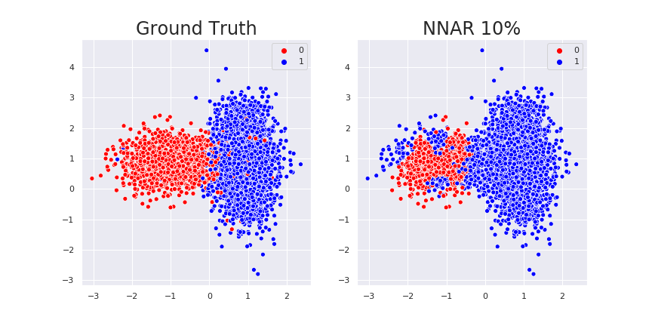
Blobs: NNAR

Slide 46
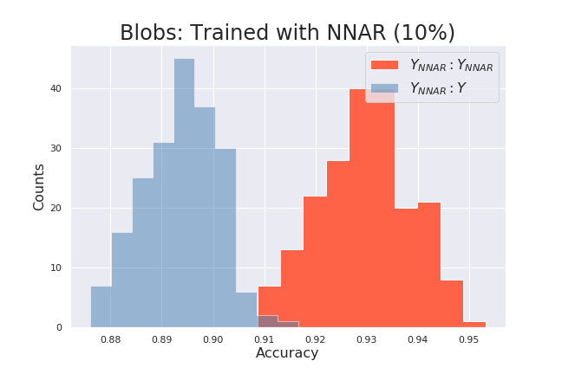
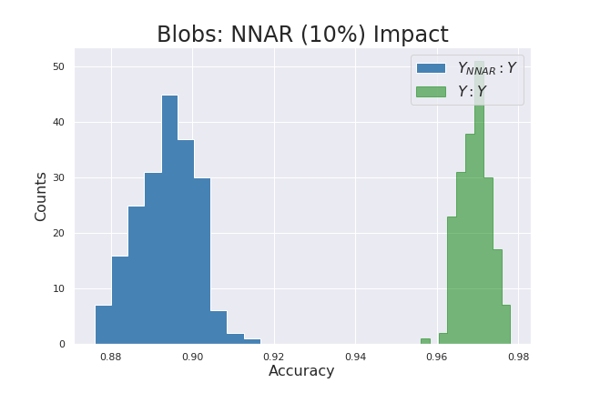
Blobs: NNAR

Slide 47
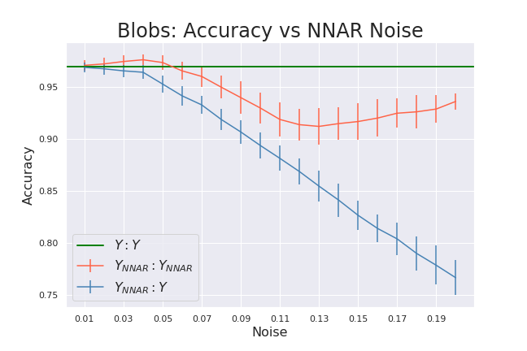

Slide 48
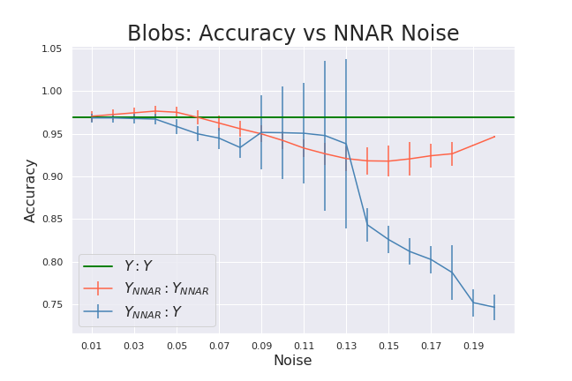
Blobs: NNAR (Tuned)

Slide 49
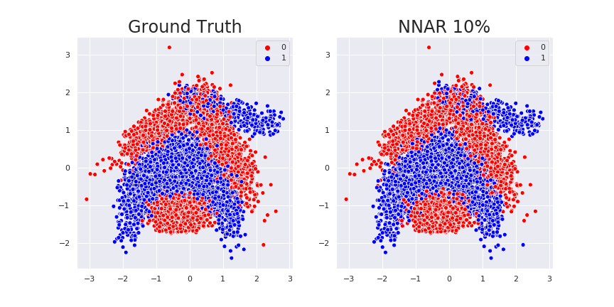
Banana: NNAR

Slide 50
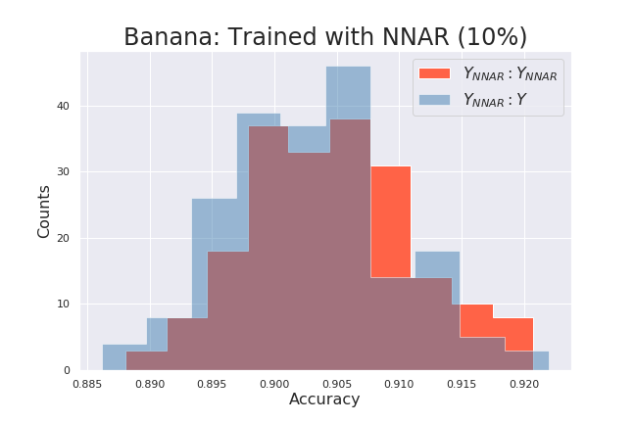
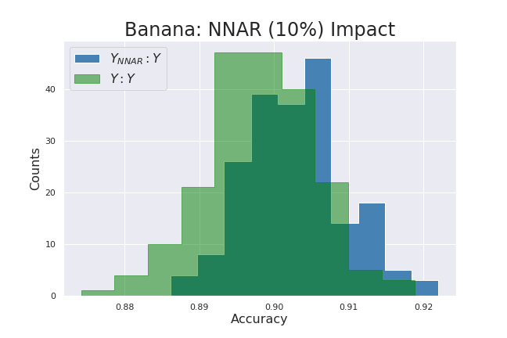
Banana: NNAR

Slide 51
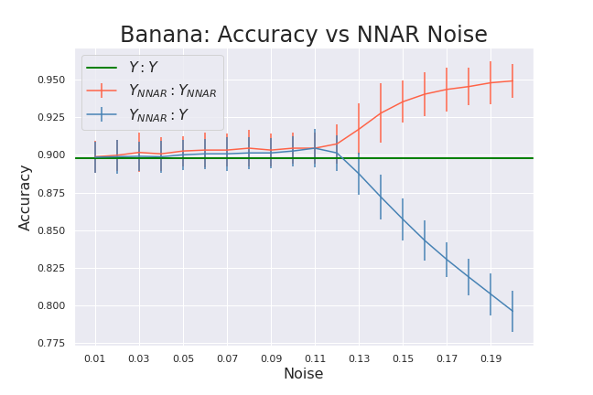

Slide 52
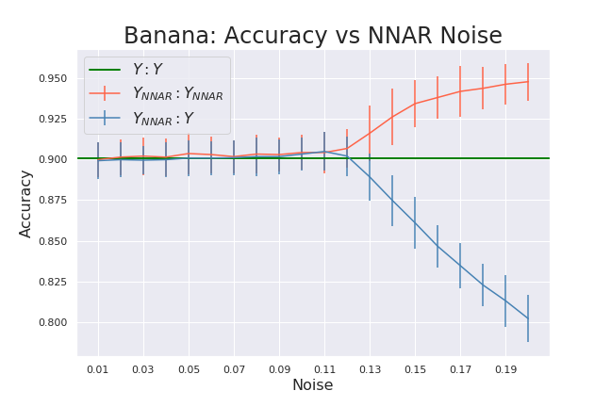
Banana: NNAR (Tuned)

Slide 53
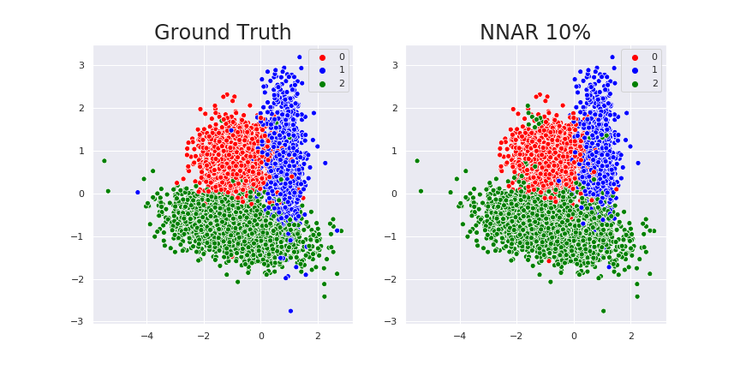
Tri-blobs: NNAR

Slide 54
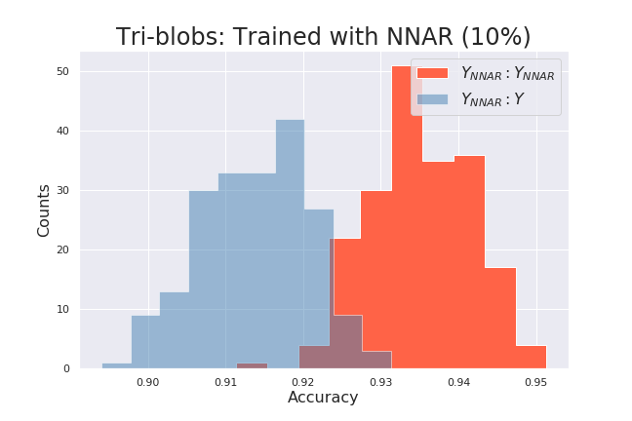
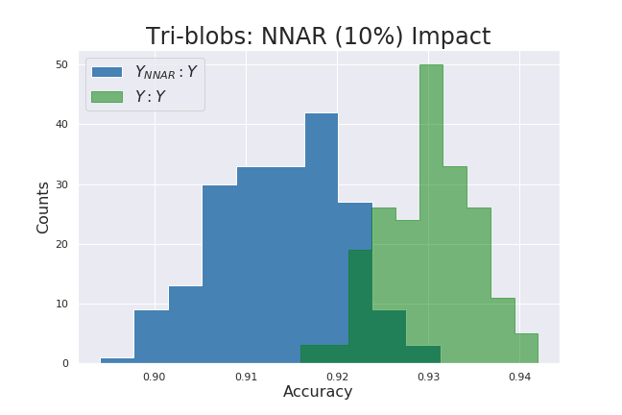
Tri-blobs: NNAR

Slide 55
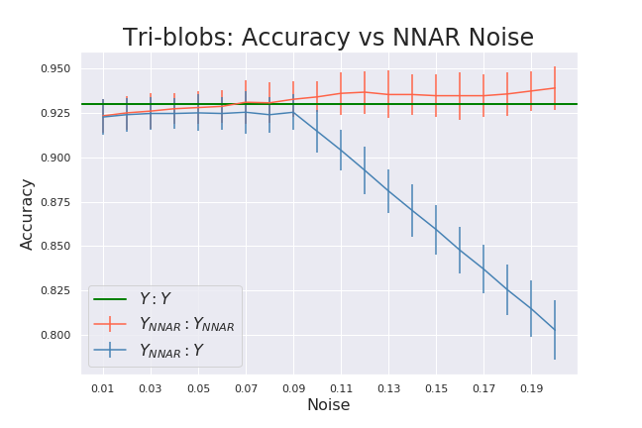

Slide 56
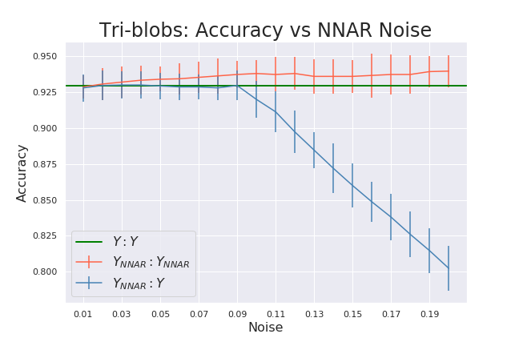
Tri-blobs: NNAR (Tuned)

Slide 57
Recap

Slide 60



Slide 61
Recap
Types of Label Noise
NCAR: Noisy Completely At Random
NAR: Noisy At Random
NNAR: Noisy Not At Random
Simulated Noise
Effects on model performance
NCAR and NAR: lower apparent performance and slightly reduced true performance
NNAR: higher apparent performance and decreased true performance
Hyperparameter tuning can help

Slide 62
Questions?
jking@xsolis.com

Slide 63
References
Frénay, B., Verleysen, M. Classification in the Presence of Label Noise: a Survey. IEEE Trans. Neural Networks and Learning Systems, 25(5), 2014, p. 845-869.
Frénay, B., Kabán A. A Comprehensive Introduction to Label Noise. In Proc. ESANN, Bruges, Belgium, 23-25 April 2014, p. 667–676.
Bootkrajang, J. and Ata K. Boosting in the presence of label noise. CoRR abs/1309.6818 (2013): n. pag.
Nematzadeh Z., Ibrahim R., Selamat A. Class Noise Detection Using Classification Filtering Algorithms. CIIS 2016. Advances in Intelligent Systems and Computing, vol 532.
Ekambaram, R., Goldgof, D.B., and Hall, L.O. "Finding label noise examples in large scale datasets," 2017 IEEE International Conference on Systems, Man, and Cybernetics (SMC), Banff, AB, 2017, pp. 2420-2424.
Oakden-Rayner, L. Exploring the ChestXray14 dataset: problems. Luke Oakden-Rayner, 18 Dec 2017, https://lukeoakdenrayner.wordpress.com/2017/12/18/the-chestxray14-dataset-problems/.
Nielsen, M. Neural Networks and Deep Learning. Determination Press, 2015.

